Slide 1
Spooky Proxemic
Terrance Mok

Slide 2
Distance & Orientation
Close & Look At
Close & Don’t Look
Far & Look At
Far & Don’t Look
Medium

Slide 3
Close & Look At
Screamer timer
Close & Don’t Look
Resets screamer timer
Far & Look Away
Scary music timer

Slide 4

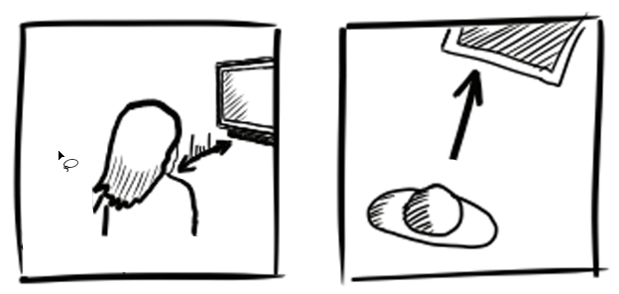
Far & Look At

Slide 5
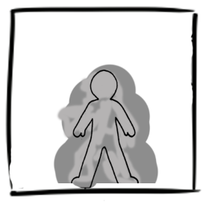
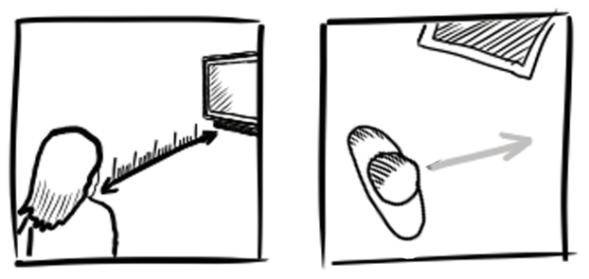
Far & Don’t Look

